Slide 1
Output screens
TF-IDF

Slide 2
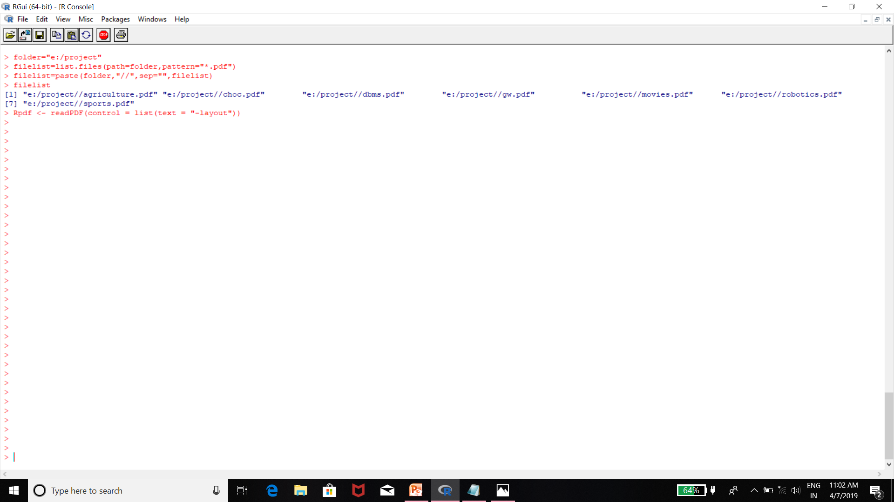
READING THE FILES

Slide 3
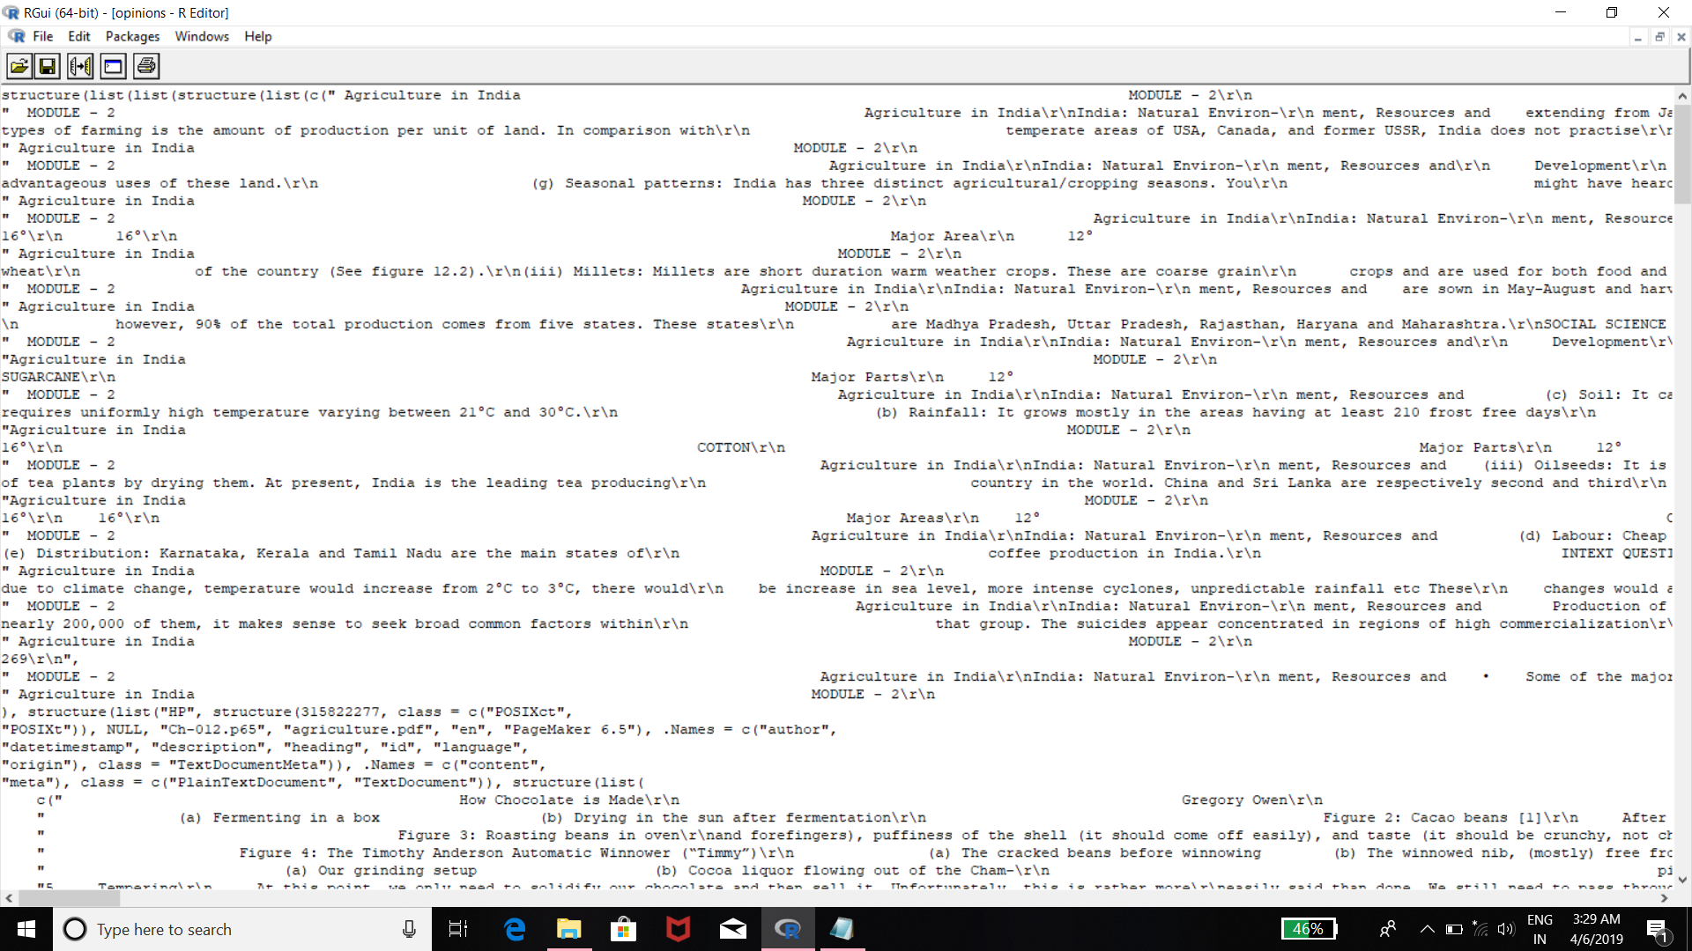
CORPUS

Slide 4
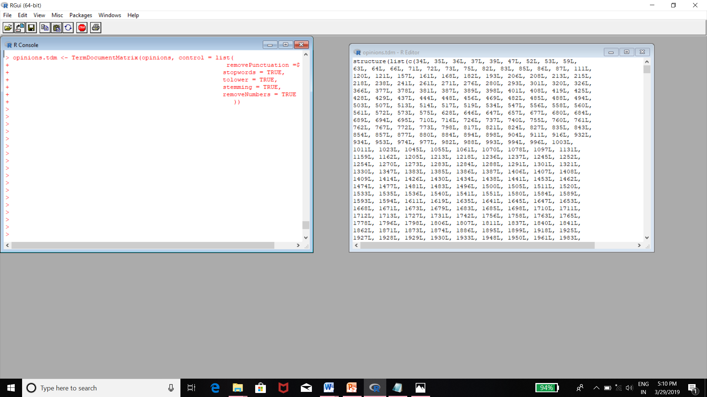
PREPROCESSING

Slide 5
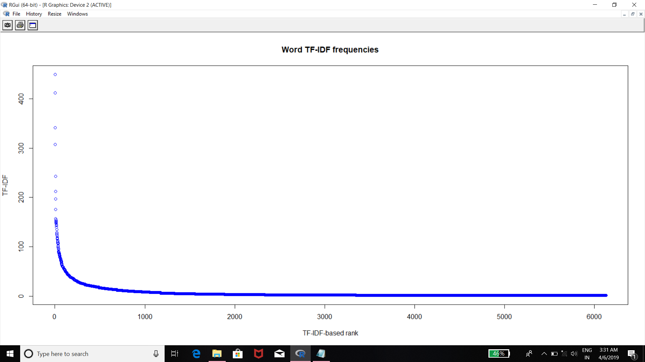
FREQUENT TERM GRAPHS

Slide 6
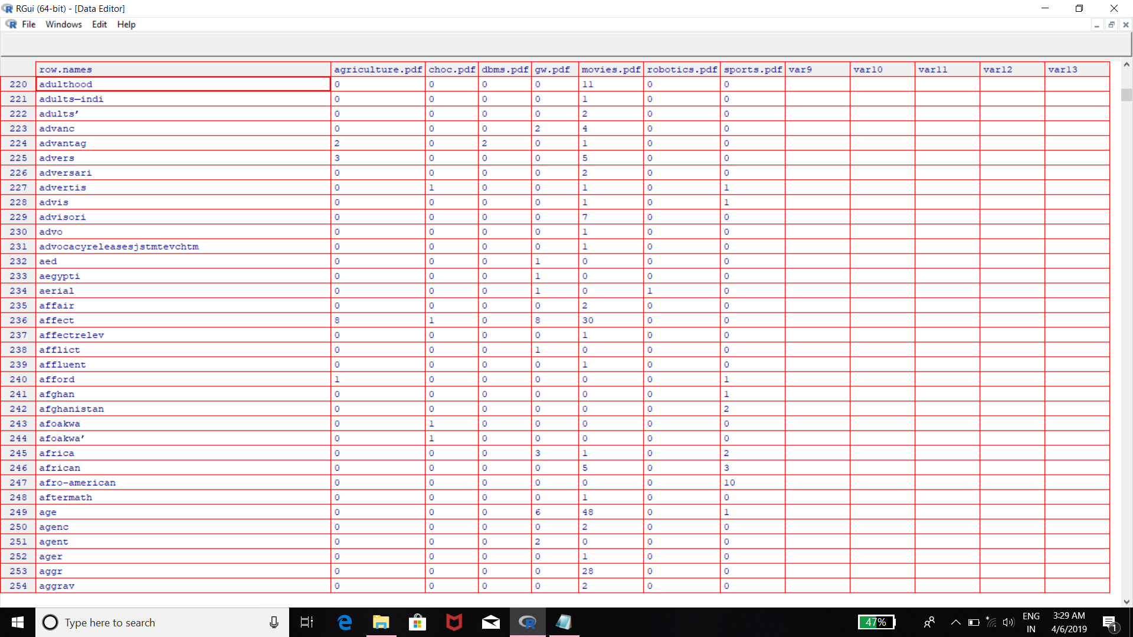
TERM DOCUMENT MATRIX

Slide 7
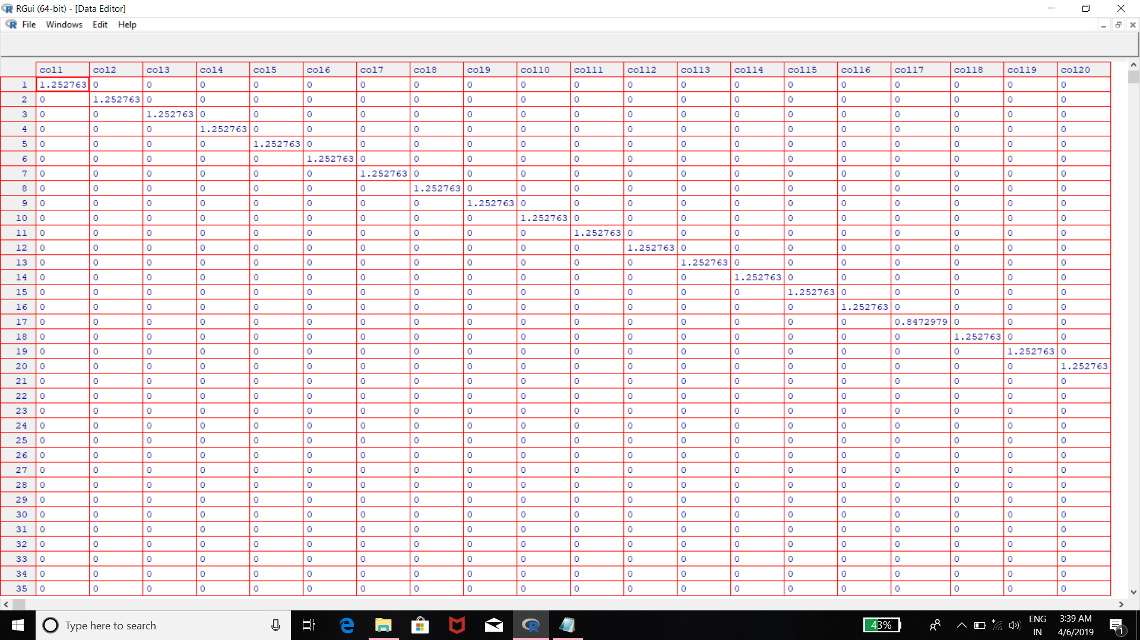
INVERSE DOCUMENT FREQUENCY

Slide 8
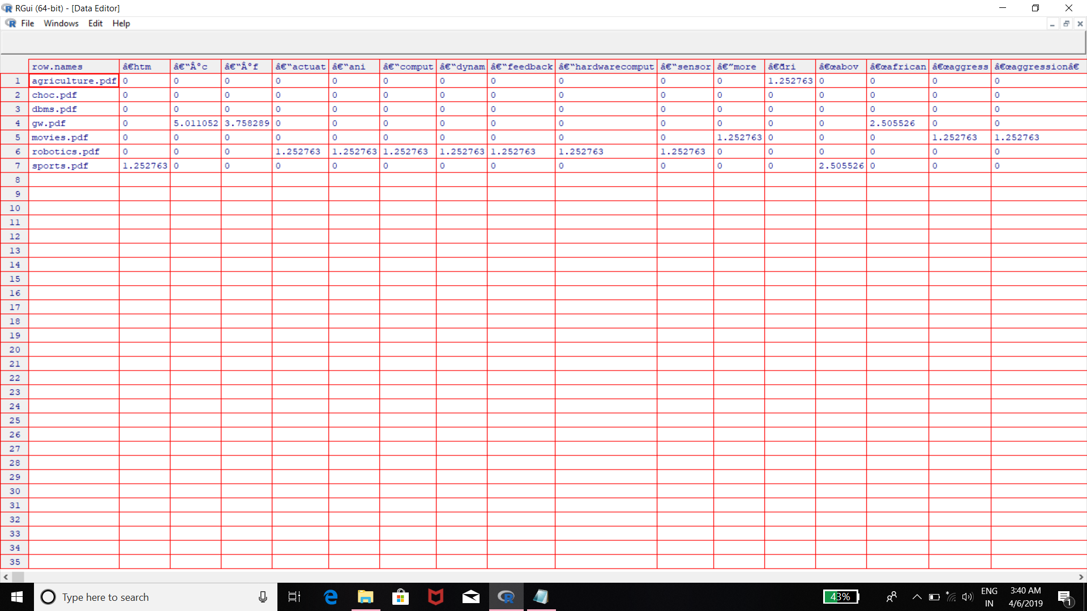
WEIGHTS

Slide 9
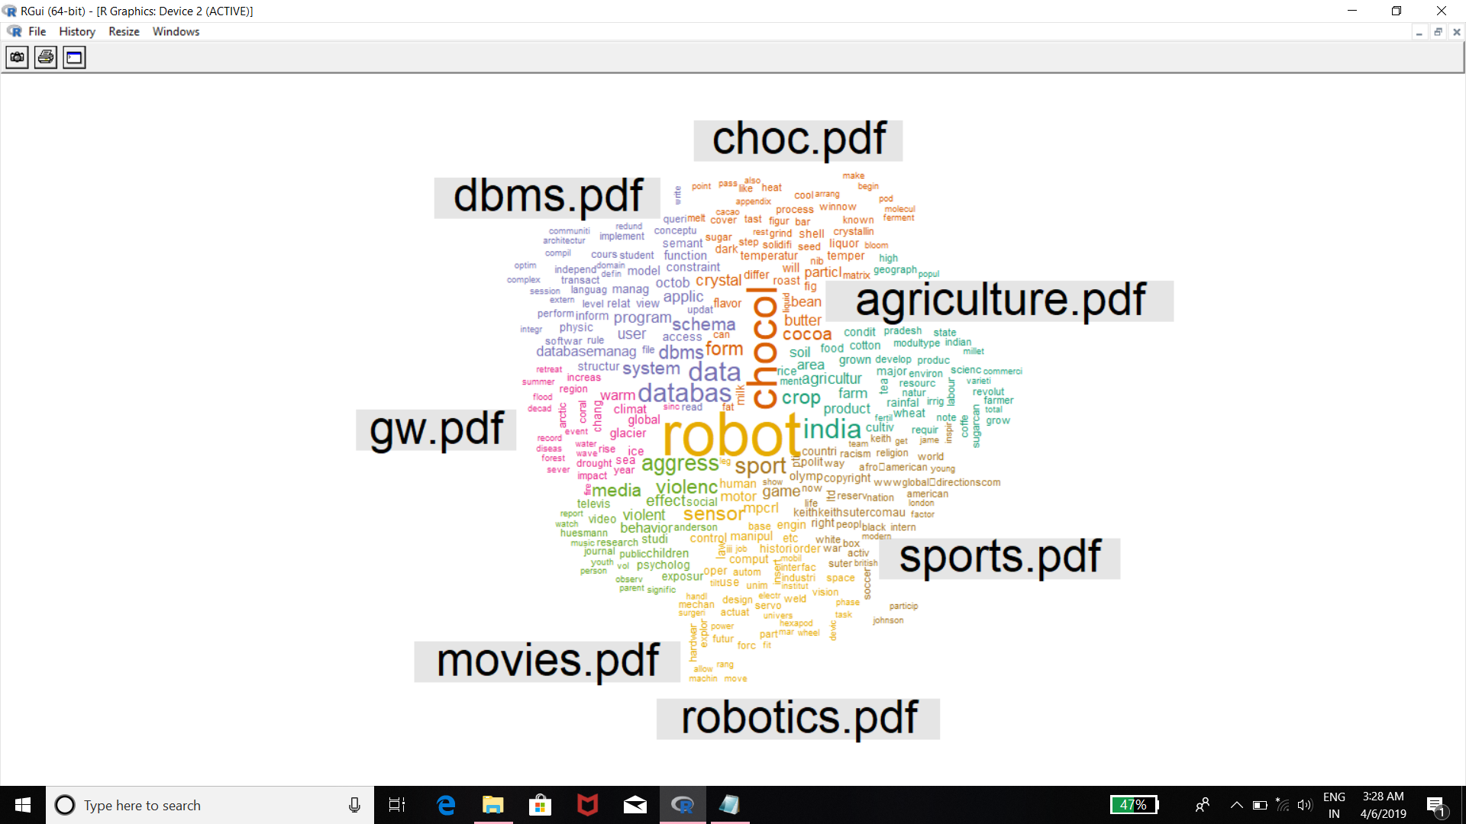
WORD CLOUD

Slide 10
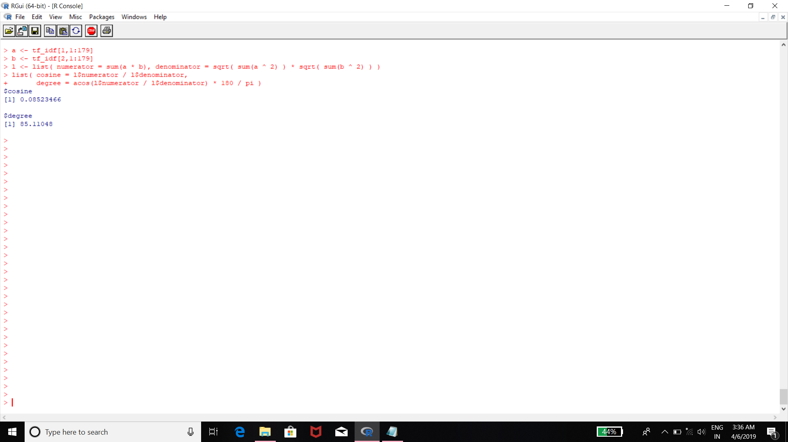
COSINE SIMILARITY

